Slide 1
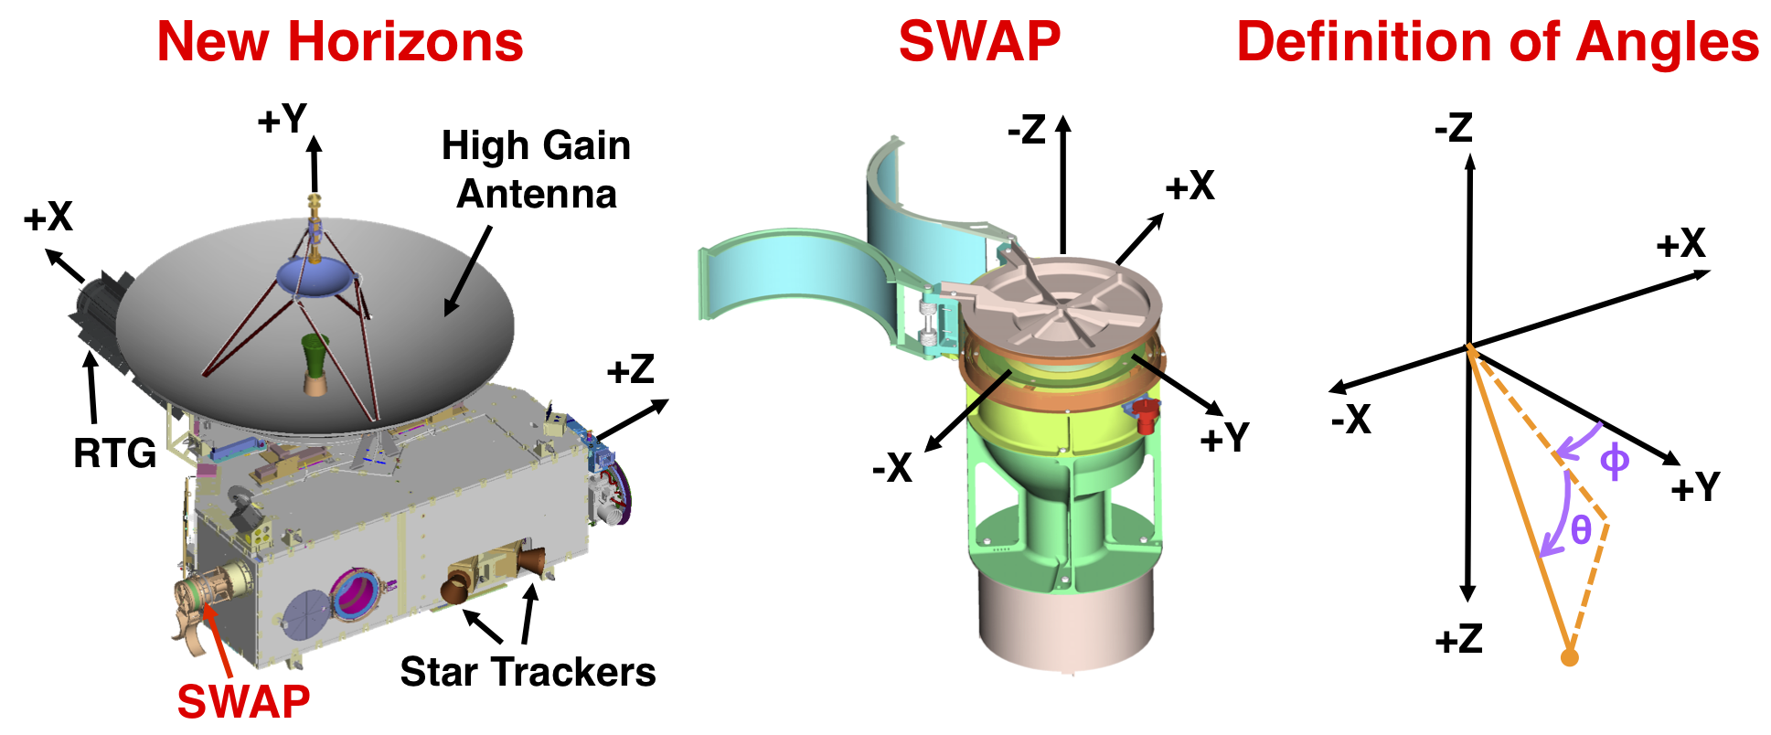
Coordinate system

Slide 2
New Horizons Trajectory

Slide 3
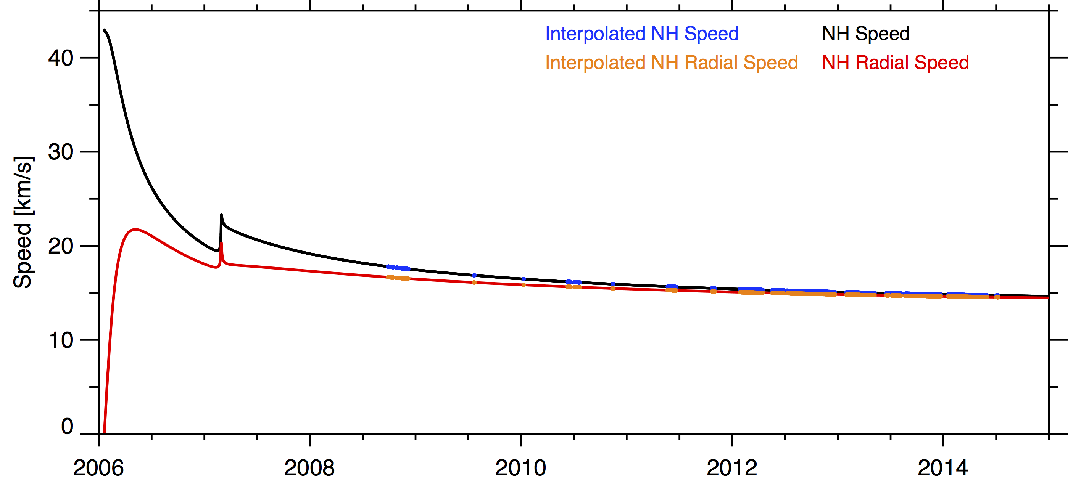
Radial Component of Spacecraft Velocity
The speed of the spacecraft is in black.
The red is the speed along the radial direction (calculation below).
In blue is the spacecraft speed interpolated to SWAP measurement time.
In orange is the spacecraft radial speed interpolated to SWAP measurement time.
Since New Horizons is moving away from the Sun the SWAP measured energy (speed) is less than it really is. To reproduce the SWAP measurements you need to lower the ion speed by radial speed of the spacecraft.

Slide 4
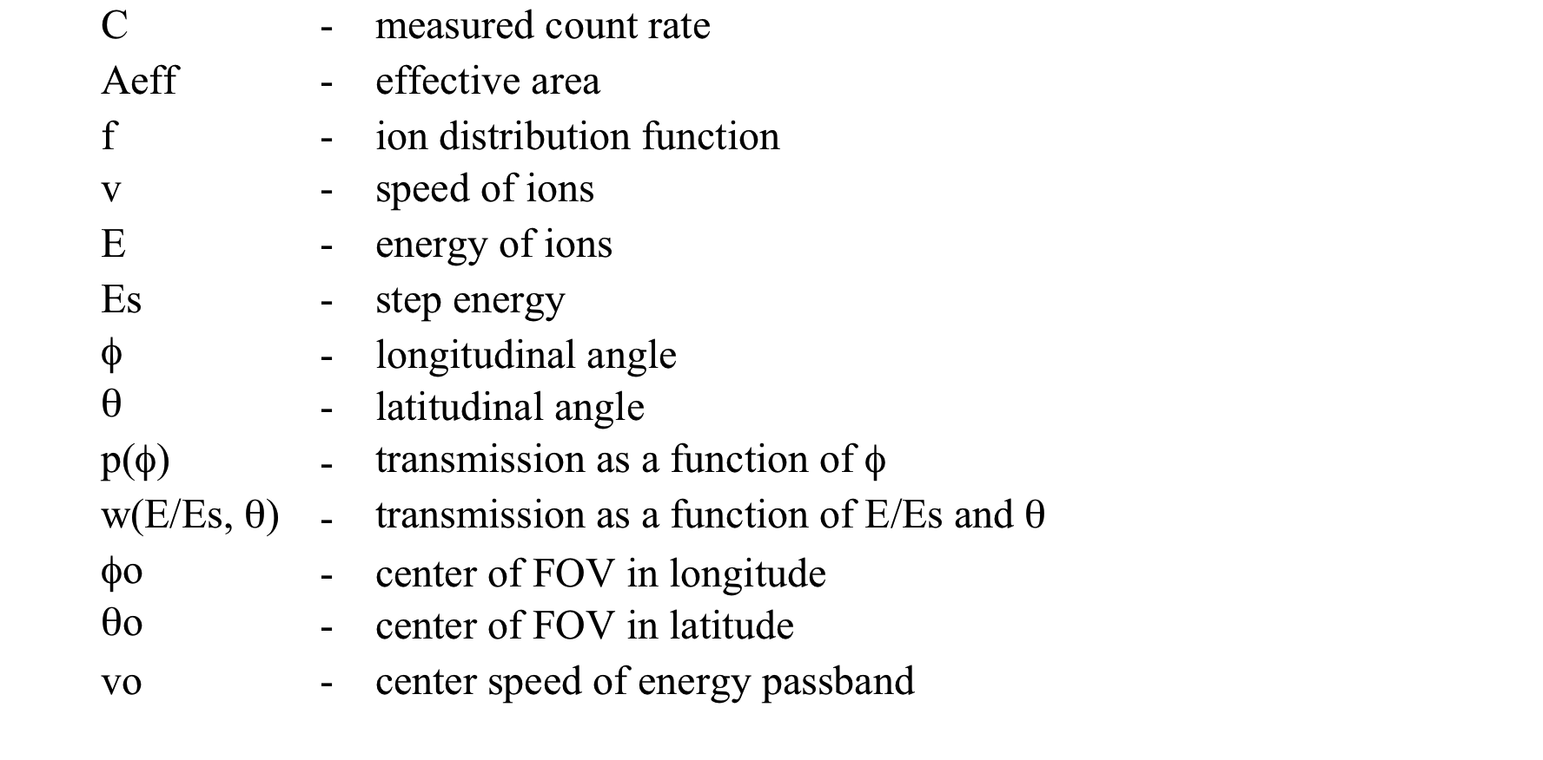
Comprehensive Model
The comprehensive model accounts for the transmission as a function of energy, and both angular directions, and spinning of the spacecraft.

Slide 5
Effective Area
The overall effective area is owing to the overall geometric throughput and the efficiency of the detectors. The detector efficiency is a function of time.
The launched over all effective area was published in McComas et al., 2008. It was 0.033 cm^{2.}

Slide 6
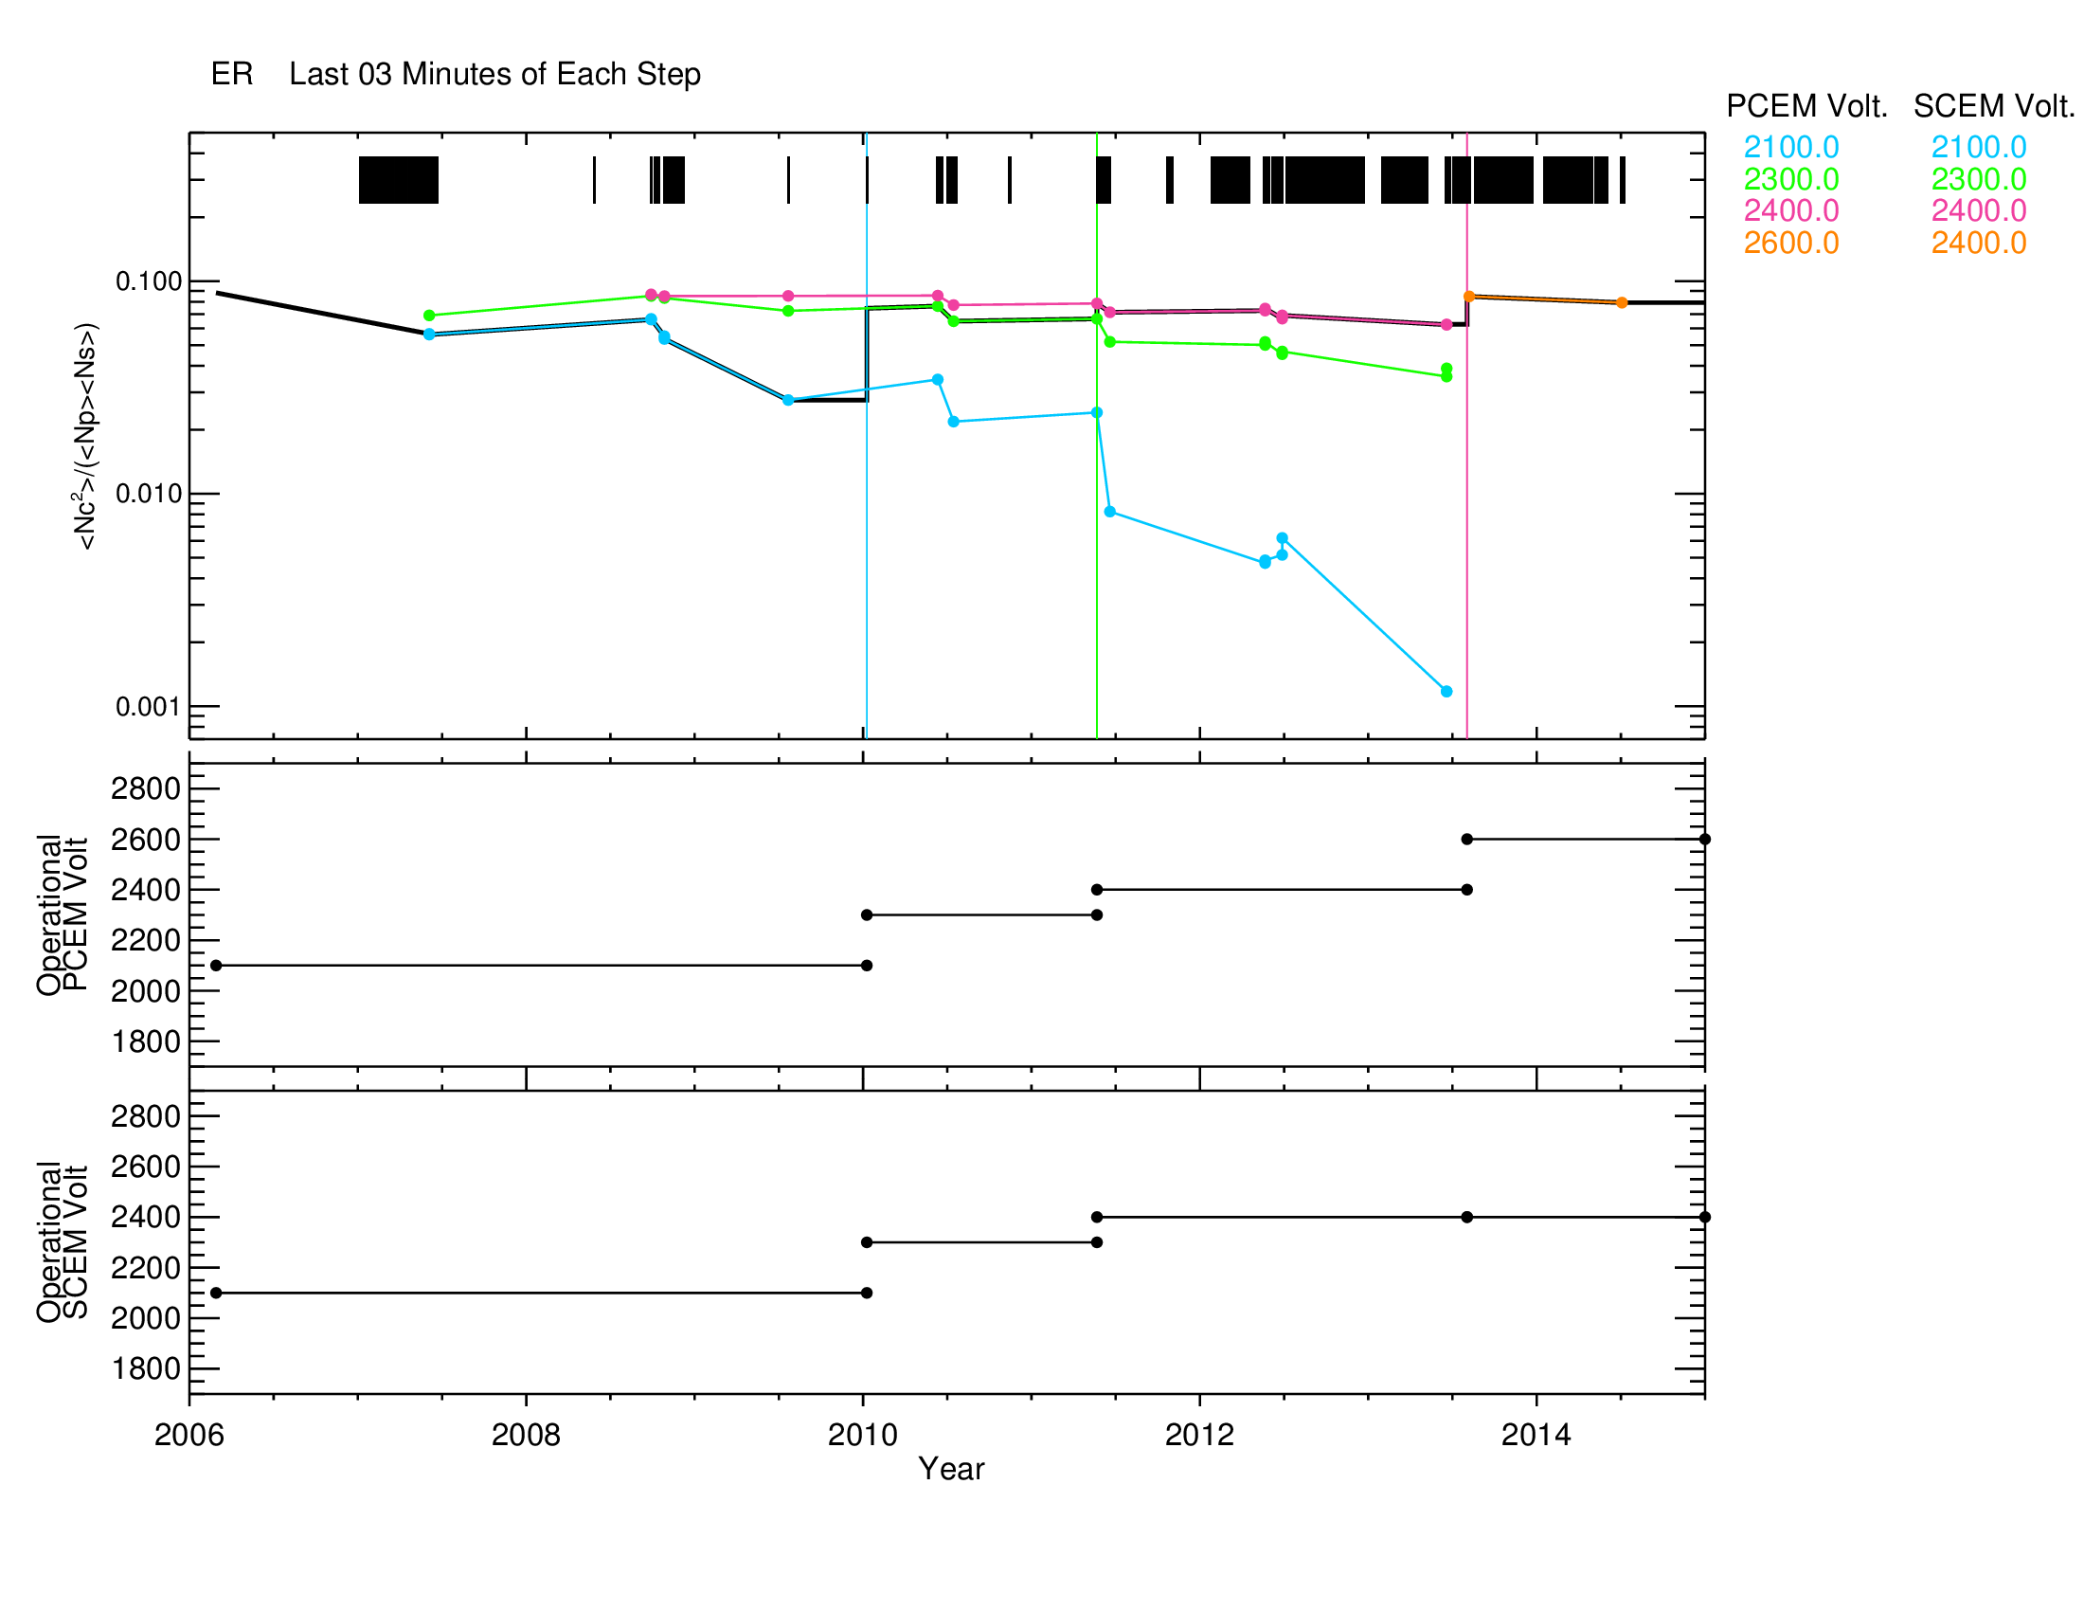
Detector Efficiency (E_{detector}) Vs Time
Detector efficiency is the coincidence rate (Nc) squared divided by the product of the primary (Np) and secondary (Ns) rates.
The top above plot shows the detector efficiency as a function of time. The black bar indicates the duty cycle of the instrument.
The efficiency points shown were taken during CEM gain tests.
The bottom plots show the CEM operation voltages.
The thick black line under the colored lines corresponds to the final lookup table values.

Slide 7
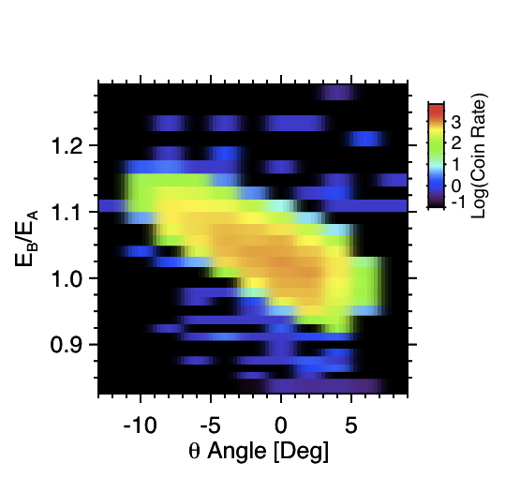
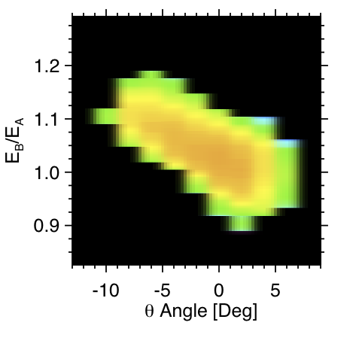
Energy-θ Response ( )
Lab Calibration
Scaled Simulation
We use the simulated energy-θ response curves scaled to match the lab calibration at 1000 eV to charcterize the energy- θ response (w(E/Es,θ)).

Slide 8
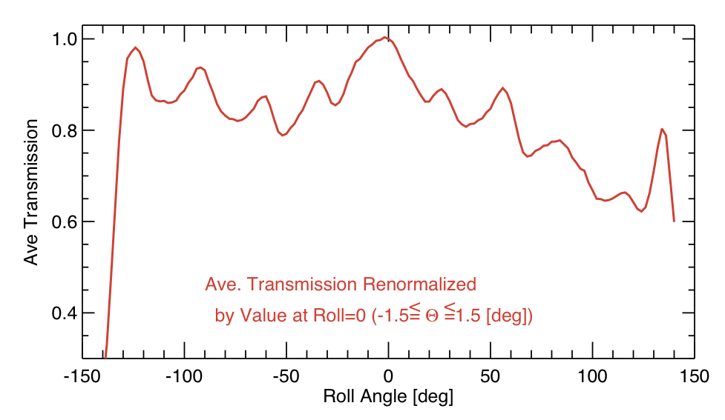
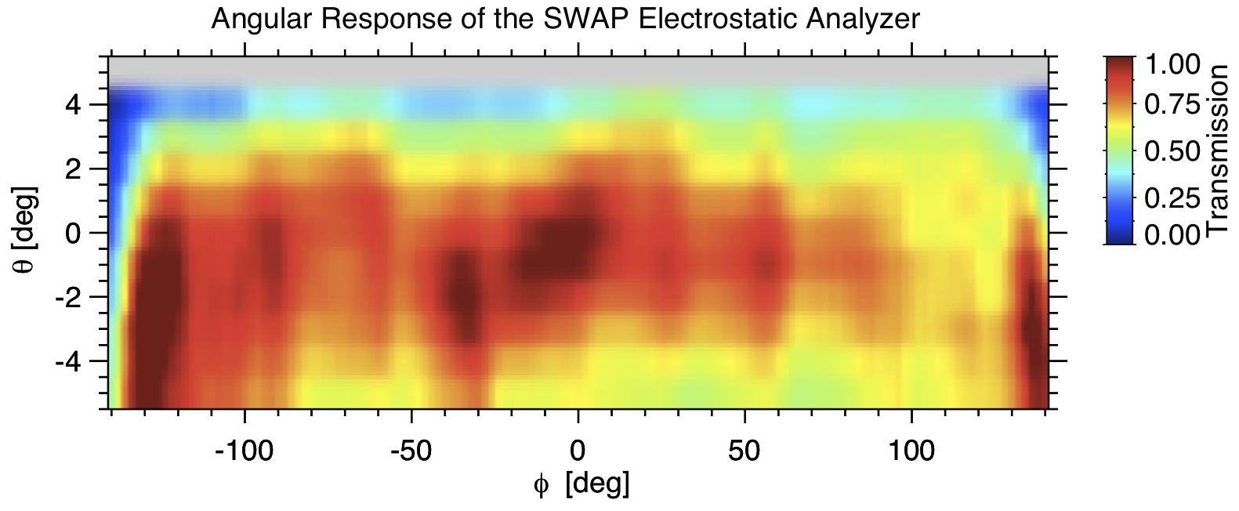
Phi Response ( )
To derive the ϕ response (shown left) we used the center of the laboratory θ and ϕ response taken with a 1000 eV beam (shown below) to characterize the ϕ angle transmission (p(ϕ)).

Slide 9
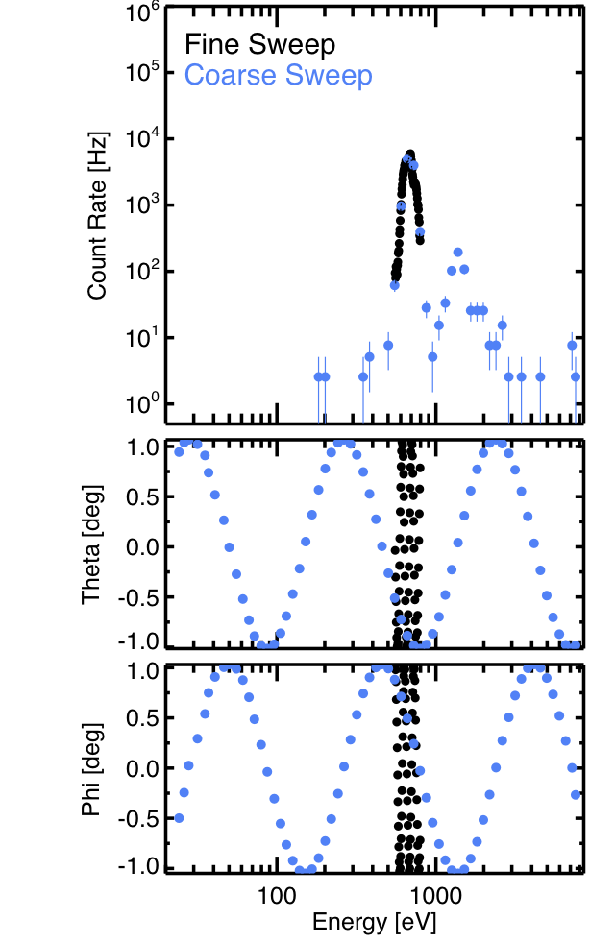
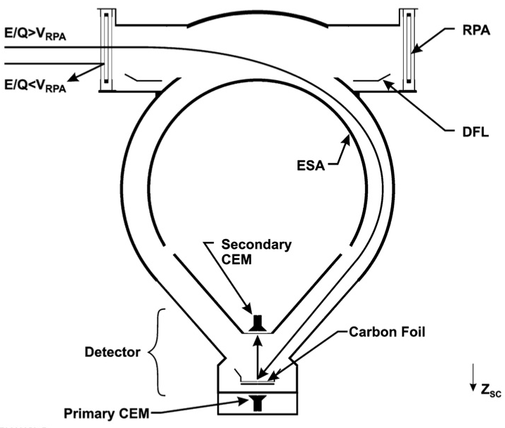
SWAP Instrument and Data
Ions that enter any where in our 10 by 276° aperture get focused onto a pair of channel electron multipliers (CEM).
Each coarse sweep has 64 steps and takes 32 sec.
Fine sweeps are centered on the peak energy found in the coarse scan and also has 64 steps taken in 32 sec.
Each step has an accumulation time of 390 msec.
_{26.96 AU}
_{08/04/2013}
H⁺
He⁺⁺

Slide 10
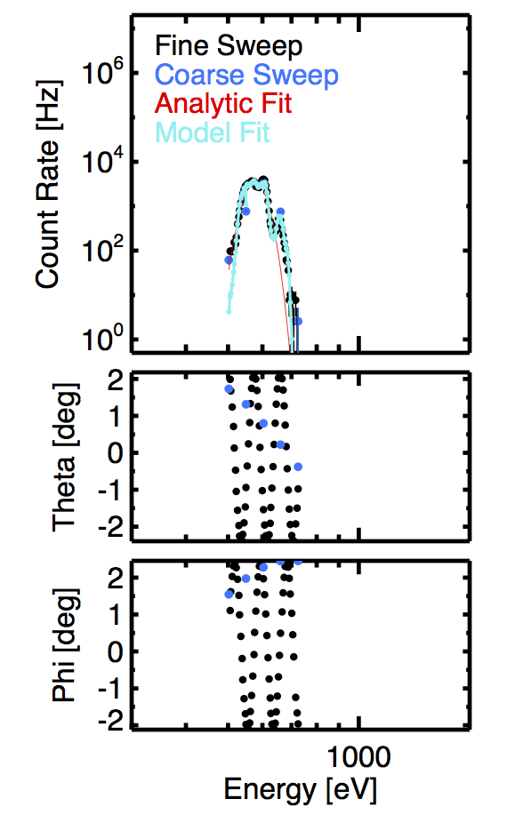
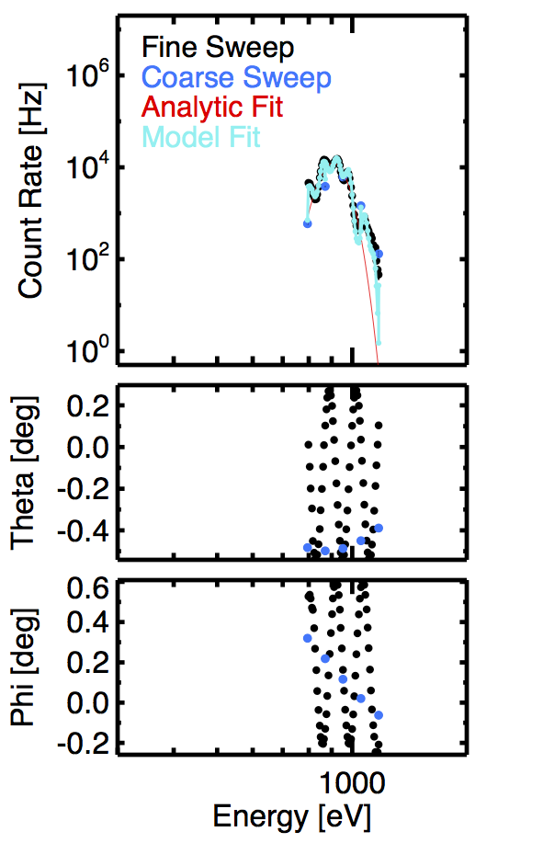
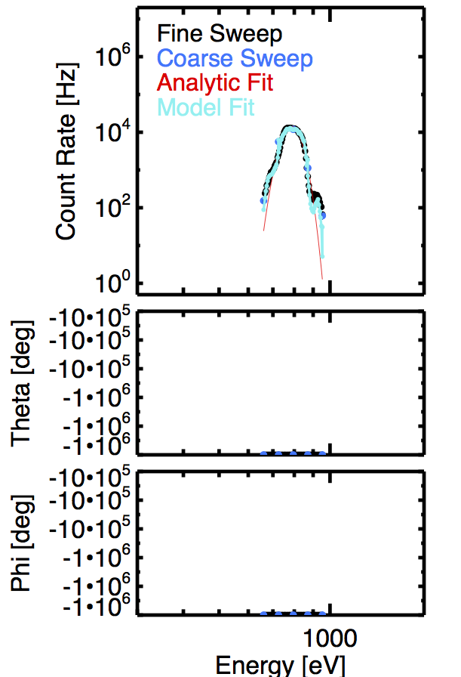

Distribution Examples at Different Distances
11.7 [AU]
17.14 [AU]
23.67 [AU]
26.95 [AU]
Hibernation
No Attitude Data
V = 352 [km/s]
N = 0.0093 [cm³]
T = 4162 K
V = 431 [km/s]
N = 0.0326 [cm³]
T = 14,600 K
V = 403 [km/s]
N = 0.0255 [cm³]
T = 5723 K
V = 372 [km/s]
N = 0.0119 [cm³]
T = 22,340 Ks
Note the small local peaks are vary with the theta and phi angles.
The bumps are why we need to account for the angle variations in the instrument response.

